Slide 1

LAPTOP PRICE PREDICTION
SANJEEV MISHRA

Slide 2
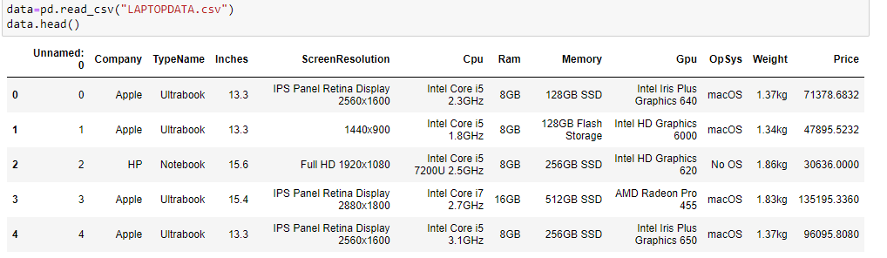

Data Set
Laptop Price Prediction
Source: GitHub
-1303 Rows x 11 Columns
- Different Columns-

Slide 3


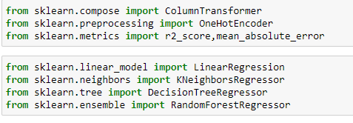
Libraries Used

Slide 4
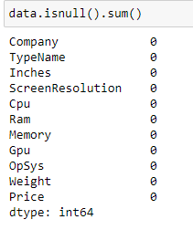
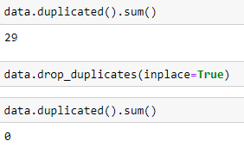
Data Cleaning:
Check the null value in the dataset.
Check the duplicate rows in the dataset.

Slide 5


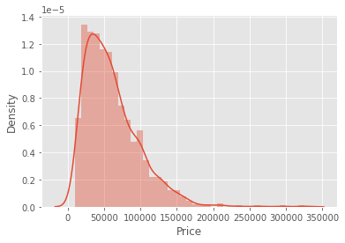

Data Transformation and Perform EDA:
Convert the object data type of the ram and weight columns into integer and float datatypes.
Make the distplot of the price columns.

Slide 6
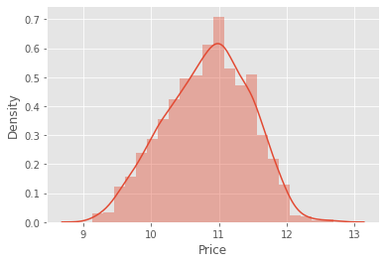
Data Transformation:
Convert the Price column into a log of the price columns to normalize the price columns.

Slide 7
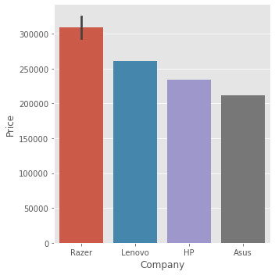
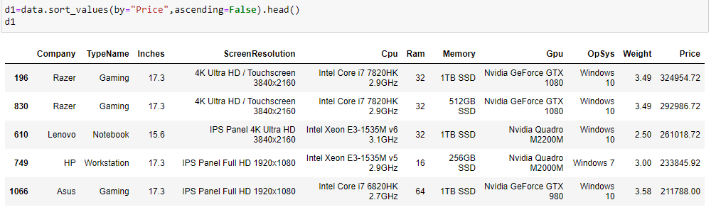
Perform EDA (Cont.…)
Top 5 Laptop which has the high prices:

Slide 8
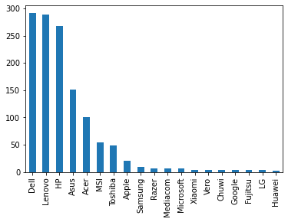

Perform EDA (Cont.…)
A count of the laptop of different companies.
The Price of the laptop of different companies.

Slide 9

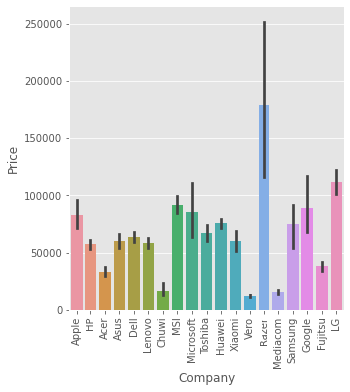
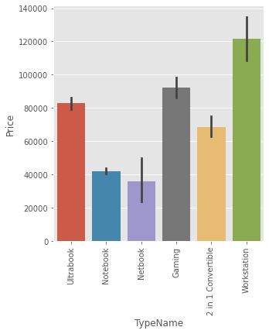
Perform EDA (Cont.…)
The Price of the different types of Laptops:

Slide 10
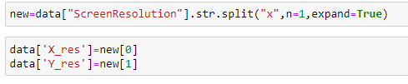
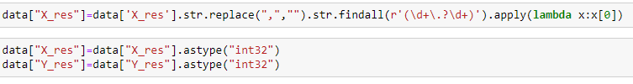
Perform EDA (Cont.…)
Split the Screen Resolution columns into four columns Touchscreen, IPS, X_res, and y_res, and then make the ppi(Pixel Per Inches) column with the help of X_res, Y_res, and inches columns.

Slide 11
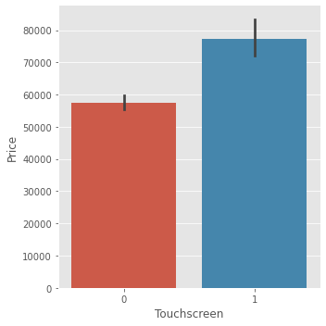
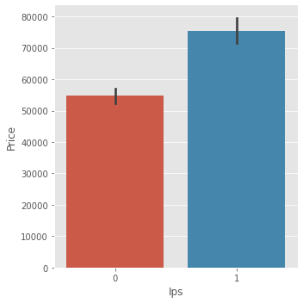
Perform EDA (Cont.…)

Slide 12
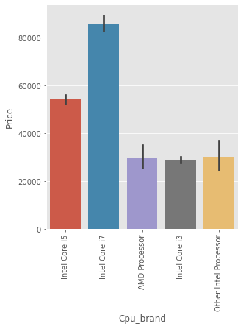
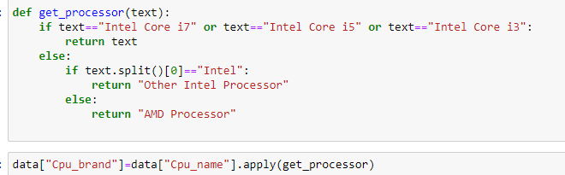

Perform EDA (Cont.…)
Change the CPU column into a CPU brand column.

Slide 13
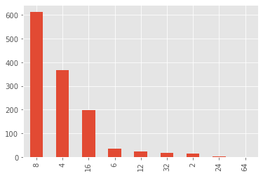
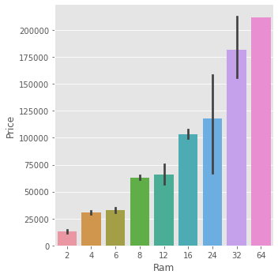
Perform EDA (Cont.…)
Count and price of the laptop by RAM:

Slide 14
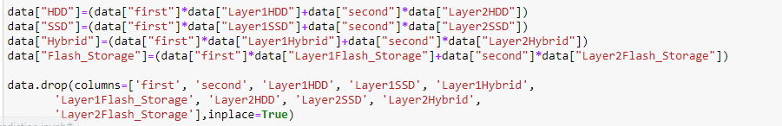
Perform EDA (Cont.…)
Split the memory columns into four types HDD, SSD, Hybrid, and Flash Storage.

Slide 15
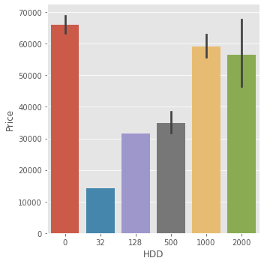
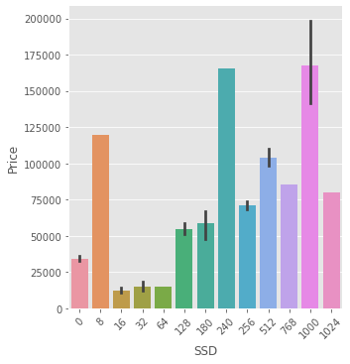
Perform EDA (Cont.…)
Price by the HDD and SSD columns:

Slide 16
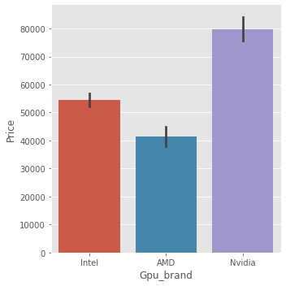
Perform EDA (Cont.…)
Convert the GPU column into the Gpu brand column:

Slide 17
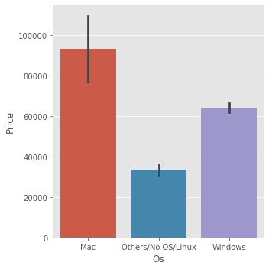
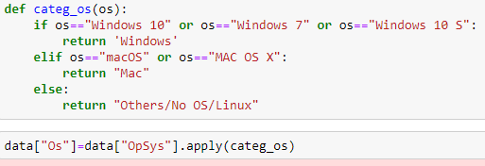
Perform EDA (Cont.…)
Convert OpSys Column into an Os column:

Slide 18
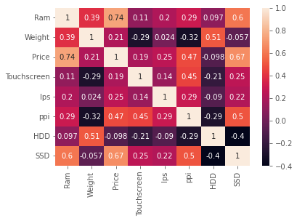


Drop Columns and Correlation Matrix:
After the transformation of columns and then drop the previous columns:
Split the Dataset for training and testing.

Slide 19
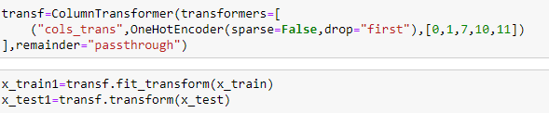



Apply OneHotEncoder
Apply the one hot encoder on the categorical columns:
Apply the Linear Regression Algorithms: Accuracy and R2 score:

Slide 20
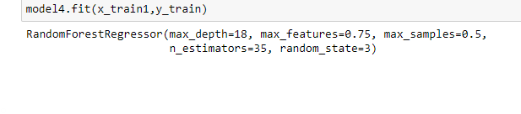


Apply Random Forest Algorithm:

Slide 21

Predict One Laptop Price:
Predict the price of the Laptop by model1 and model4.
The price of the laptop by model 1 is 77906.80.
The price of the laptop by model 4 is 59400.70.

Slide 22
Conclusions:
The price of the laptop depends on various factors like Company, Type of the laptop, Ram, CPU type, GPU, Touchscreen, IPS, HDD, and SSD.
Laptops of Razer Company have the maximum price.
The laptop having IPS and Touchscreen have more price.
Intel Core i7 has the maximum price.
Nvidia GPU has the maximum price.
Workstation type of laptop have maximum price.
The screen resolution column converts into a PPI column. The increase in the PPI column causes an increase in price.

Slide 23
Thank You

